Slide 1
Mathematical Modeling in Biology:
USMAN PAGALAY
Department of Mathematics
ISLAMIC STATE University of MALANG.
usman@math.uin-malang.ac.id

Slide 2
Overview
Mathematical modeling
  Curve fitting, simulation, and modeling
  Models in biology vs models in physics
  Modeling by discovery
Examples
  Structured populations
  Pharmacokinetics
  Predator-prey dynamics
  Resource management

Slide 3
Mathematical Models
A mathematical model is a well-defined mathematical object consisting of a collection of variables and rules governing their values.
Models are created from assumptions inspired by observation of some real phenomena in the hope that the model behavior resembles the real behavior.

Slide 4
Curve Fitting and Simulation
Using data to obtain parameter values is curve fitting, not modeling.
  There is an underlying model in parameter determination, but the model is assumed.
Using a computer to predict the behavior of some real scenario is simulation, not modeling.
  Simulation involves computation with an assumed model.

Slide 5
Mathematical Modeling
Mathematical modeling is the process of constructing, testing, and improving mathematical models.
Mathematical models should be general in the sense of containing parameters that can be adjusted to strengthen, weaken, or modify the behavior of each process.
They do not need to be general in the sense of working for all possible cases.

Slide 6
Models in Biology and Physics
Most physical processes are well described by “physical laws” valid in a wide variety of settings.
  It is easy to get physical science models right.
Most biological processes are too complicated to be described by simple mathematical formulas.
  It is hard to get good models for biology.
  A model that works in one setting may fail in a different setting.

Slide 7
Modeling by Discovery
Mathematical modeling requires good scientific intuition.
Scientific intuition can be developed by observation.
Detailed observation in biological scenarios can be very difficult or very time-consuming, so can seldom be done in a math course.

Slide 8
Presenting “bugbox”, a simple computer simulation for structured population dynamics!
Because bugbox is a simulation, its behavior doesn’t necessarily match any real insect population. It functions as a biology lab for a virtual world.
The front-end for bugbox is not quite finished. Eventually, it will run as a maplet on a server at the UNL Math Department.

Slide 9
Structured Population Dynamics
The final “bugbox” model:
Let L_{t} be the number of larvae at time t.
Let J_{t} be the number of juveniles at time t.
Let A_{t} be the number of adults at time t.
L_{t+1} = s_{L} L_{t} + f A_{t}
J_{t+1} = s_{J} J_{t} + p_{L} L_{t}
A_{t+1} = s_{A} A_{t} + p_{J} J_{t}

Slide 10
Things to do with the model:
Write as x_{t+1} = M x_{t} .
Run a simulation to see that x evolves to a fixed ratio independent of initial conditions.
Obtain the problem M x_{t} = λ x_{t} .
Develop eigenvalues and eigenvectors.
Show that the term with largest |λ| dominates and note that the largest eigenvalue is always positive.
Note the significance of the largest eigenvalue.
Use it to predict long-term behavior and discuss its shortcomings.

Slide 11
Pharmacokinetics
Q(t)
k₁ x
blood
tissues
k₂ y
x(t)
y(t)
r x
x′ = Q(t) – (k₁+r) x + k₂ y
y′ = k₁ x – k₂ y

Slide 12
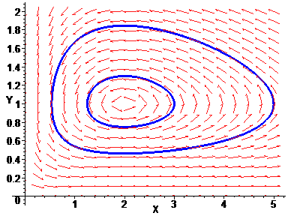
Predator-Prey Dynamics
Lotka-Volterra
  x = prey, y = predator
  x′ = r x – s x y
  y′ = e s x y – m y
  Predicts oscillations of varying amplitude

Slide 13
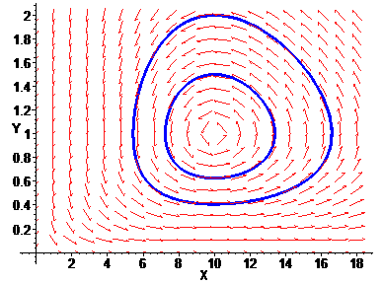
Predator-Prey Dynamics
Lotka-Volterra
  x = prey, y = predator
  x′ = r x – s x y
  y′ = e s x y – m y
  Predicts oscillations of varying amplitude
  Predicts impossibility of predator extinction.

Slide 14
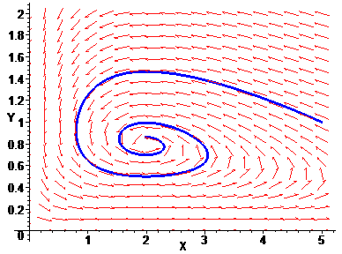
Predator-Prey Dynamics
logistic
  x = prey, y = predator
  x′ = r x (1 – — ) – s x y
  y′ = e s x y – m y
  Predicts stable x y equilibrium if m is small enough
x
K

Slide 15
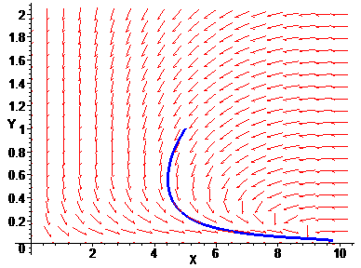
Predator-Prey Dynamics
logistic
  x = prey, y = predator
  x′ = r x (1 – — ) – s x y
  y′ = e s x y – m y
  Predicts stable x y equilibrium if m is small enough and y→0 if m too large
x
K

Slide 16
Predator-Prey Dynamics
Holling type 2
  x = prey, y = predator
  x′ = r x (1 – — ) – —–––
  y′ = —––– – m y
x
K
s x y
1 + H x
e s x y
1 + H x

Slide 17
s x y
1 + H x
Why —––– ?
Let s be search rate
Let P be predation rate per predator
Let f be fraction of time spent searching
Let h be the time needed to handle one prey
P = f s x and f + h P = 1
P = —––––
s x
1 + sh x

Slide 18
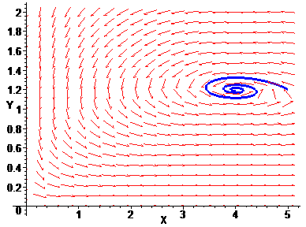
Predator-Prey Dynamics
Holling type 2
  x = prey, y = predator
  x′ = r x (1 – — ) – —–––
  y′ = —––– – m y
  Predicts stable x y equilibrium if m is small enough.
x
K
s x y
1 + H x
e s x y
1 + H x

Slide 19
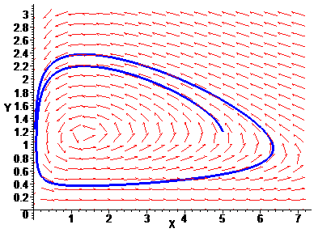
Predator-Prey Dynamics
Holling type 2
  x = prey, y = predator
  x′ = r x (1 – — ) – —–––
  y′ = —––– – m y
  Predicts stable x y equilibrium if m is small enough and stable limit cycle if m is even smaller.
x
K
s x y
1 + H x
e s x y
1 + H x

Slide 20
Resource Management
Holling type 3
  x = resource, y = consumer
  x′ = r x (1 – — ) – —––––
  y′ = —–––– – m y
  Now assume y is a parameter.
x
K
s x ² y
1 + H x²
e s x ² y
1 + H x²
  x′ = r x (1 – — ) – —––––
x
K
c x ²
1 + H x²

Slide 21
  x′ = r x (1 – — ) – —––––
x
K
c x ²
1 + H x²
Things to do with the model:
Nondimensionalize it.
C X ²
A + X²
  X′ = X (1 – X ) – —–––
Find equilibrium solutions graphically.
Create a bifurcation diagram for given A.
Choose C to optimize yield [ X (1 – X) ]

